Slide 1
Azure Arc enabled Machine Learning
Seamless AzureML experience across multi-cloud, on-premises, and the edge
Azure ML PM Team

Slide 2
Azure Arc-enabled ML and Azure services
Azure Machine Learning platform: Accelerate e2e machine learning lifecycle on training, inference, compute/model/data management
Azure Arc: Hybrid and multiple cloud management
AMLArc: combination capabilities of AML and Arc
Notes:
Manage Kubernetes cluster across data centers, multicloud, and edge

Slide 3
Session learning objective
At the end of this session, you should be able to…
Bring your own Kubernetes cluster on-premises or in cloud to Azure ML
Use Arc-enabled compute target in AzureML Workspace for training or inference
Use Arc-enabled compute target in AzureML Workspace for interactive development

Slide 4
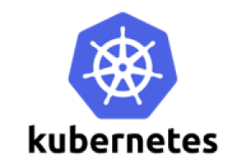


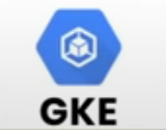


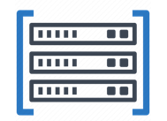
What is Azure Arc enabled ML (AMLArc)
Bring your own Kubernetes compute anywhere in cloud or on premises
A unique compute target in AzureML for both training and inference
Run any ML workload with seamless AzureML experience
Single node or distributed training
Interactive development
AutoML, ML Pipeline, Hyper parameter tuning
Real-time/ batch inference
Data on-premise or in cloud
Notes:
This is the first time, Azure ML brings hybrid capabilities to users.

Slide 5
Why Azure Arc enabled ML
Co-locate compute and data anywhere
Meet compliance and security in a highly regulated environment
Harness existing on-premise IT investment
Consistent cloud native DevOps and MLOps practices across enterprise

Slide 6
How it works – user flow
Connect
Connect Kubernetes cluster via Azure Arc
Deploy
Deploy AzureML extension
Attach
Attach cluster to AzureML workspace and create compute target
Use
Use compute target to submit training job or deploy a trained model

Slide 7
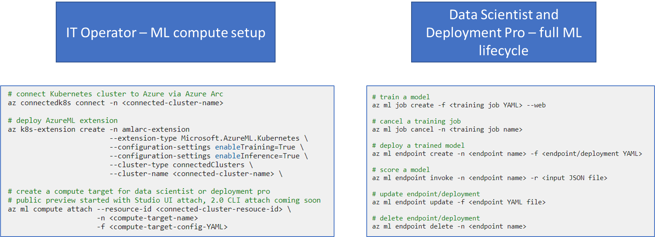
How it works – simple Azure CLI

Slide 8


How it works - architecture
AzureML Workspace and services
AzureML CLI
Cloud
3) Train/deploy model
DS/MLE
SDK Studio UI
Kubernetes
2) Create compute target
Training Operator
Inference Operator
1) Deploy AzureML extension
Cluster Admin
Azure CLI k8s-extension
Cloud or on-premise
Infra Operator
ML Workload

Slide 9
Built-in AML features
Built-in AML features
Single-node training job
Distributed training – PyTorch, TensorFlow, MPI
Hyper parameter tuning
AML pipeline
AML Designer
AML Datastore and Dataset to access cloudlet data
Interactive Job (preview)

Slide 10
Built-in AML features
AMLArc Unique features
Train or deploy models on heterogeneous or homogeneous Kubernetes cluster
Manage different team’s ML workload with familiar Kubernetes concepts (namespace, nodeSelector)
Attach Kubernetes cluster to multiple workspace and multiple instance types definition
Model training with on-premise (NFS and more to come) data access
MLOps on the same cluster from model training to deployment access
Use Managed Identity to grant resources permission to AMLArc compute (coming soon)

Slide 11
Deep Dive

Slide 12
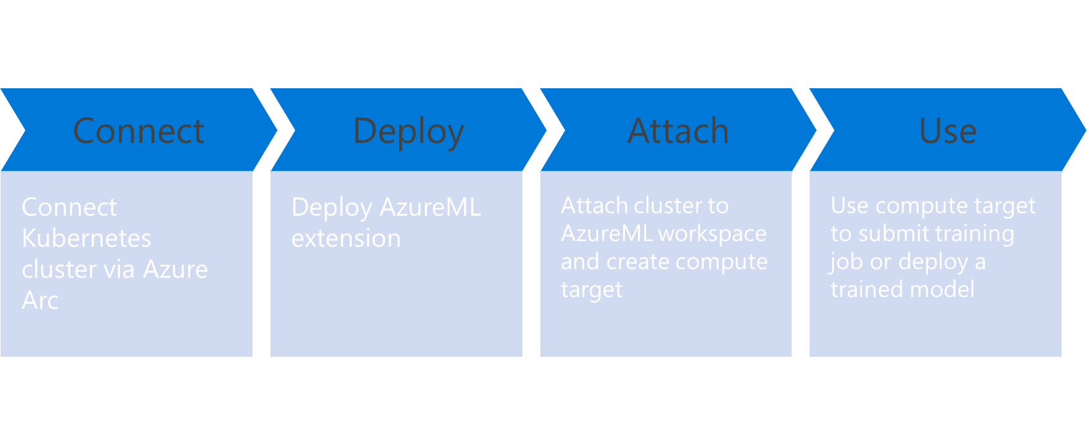
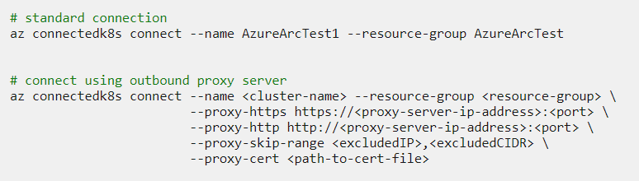
Connect to Azure Arc
A Kubernetes cluster is up and running
Access to kubeconfig
Install connectedk8s Azure CLI
Official documentation

Slide 13
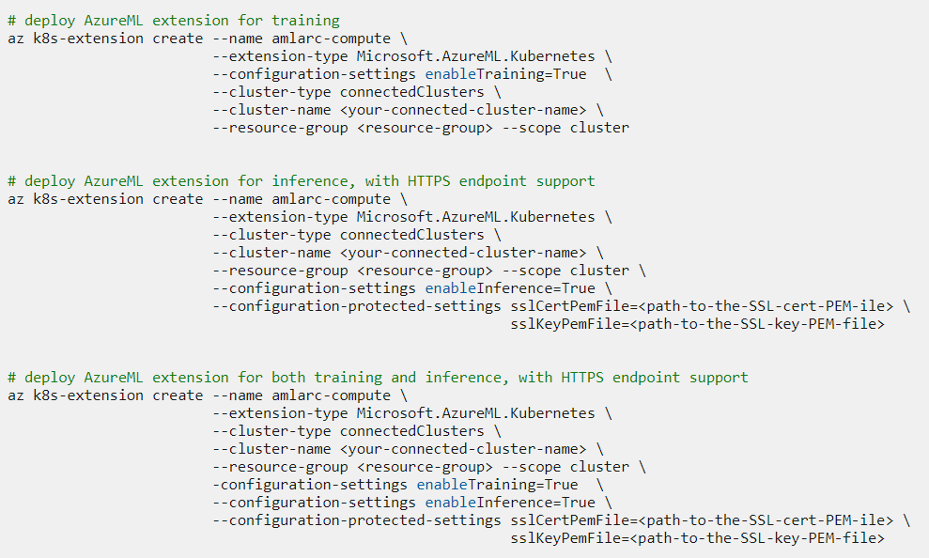
Deploy AzureML extension
Kubernetes ML capability is determined at AzureML deployment time and can’t be updated
Deploy AzureML for training
Deploy AzureML for inference
Deploy AzureML for both training and inference

Slide 14
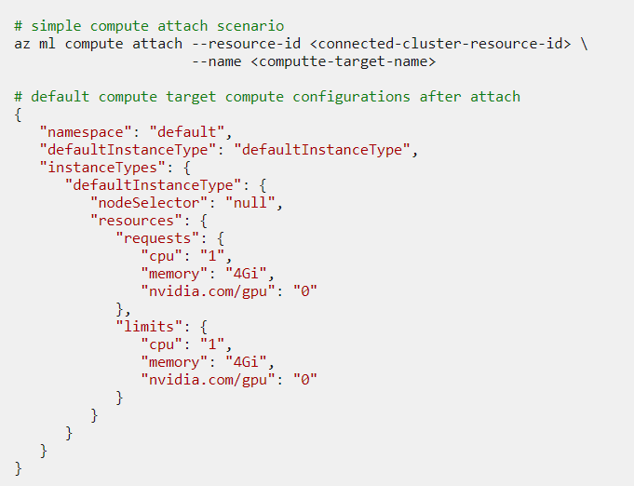
Attach cluster to AzureML workspace – simple scenario
Create an AzureML workspace if it doesn’t already exist
Simple attachment with Studio GUI or CLI.
Default configuration 1 vCPU and 4Gb memory for training job pod

Slide 15
Attach cluster to AzureML Workspace – Advanced
Create an AzureML workspace if it doesn’t already exist
Attach cluster to AzureML workspace by using default compute configuration YAML

Slide 16
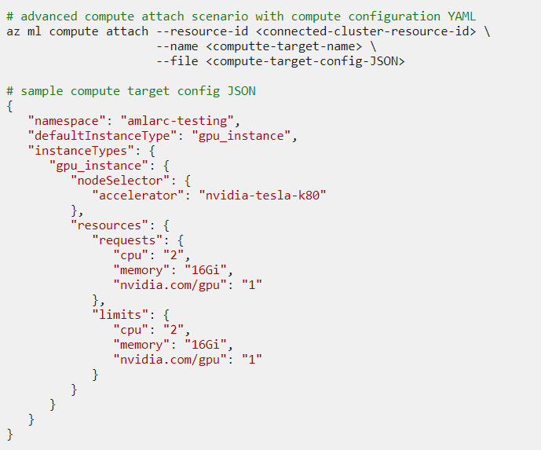
Attach cluster to AzureML Workspace – Advanced
Create an AzureML workspace if it doesn’t already exist
Attach cluster to AzureML workspace by using default compute configuration YAML
Customize the config YAML:
Namespace
Default instance type for the compute target
List of instance types
Node selector
Resource requests/limits
Notes:
The instance type is the minimum job execution unit. In job submission, data scientists can specify instance type and instance count.

Slide 17
Attach cluster to AzureML Workspace – Advanced
Use namespace to isolate workload for different projects or teams
Targeting node pool for training job submission or model deployment – node selector
Create a compute target with multiple instance types
Notes:
The instance type is the minimum job execution unit. In job submission, data scientists can specify instance type and instance count.

Slide 18
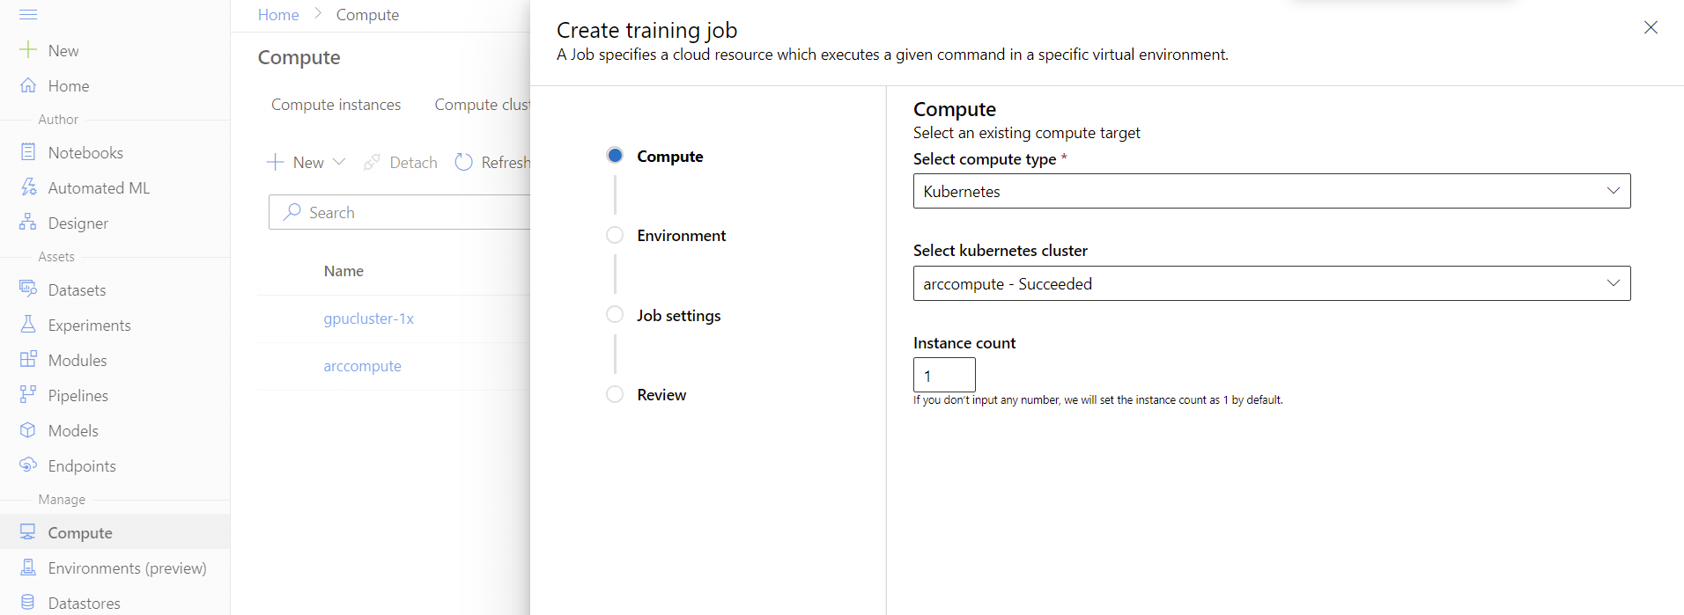
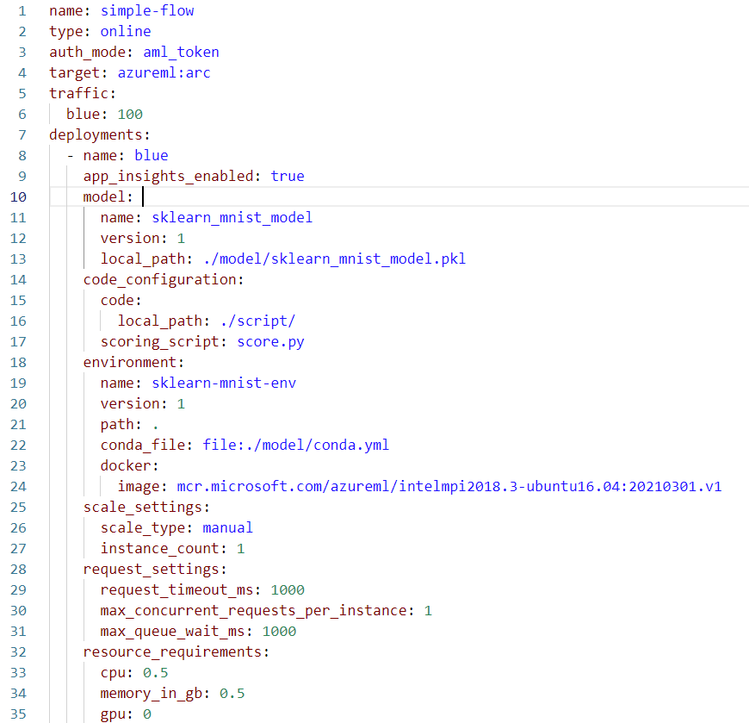
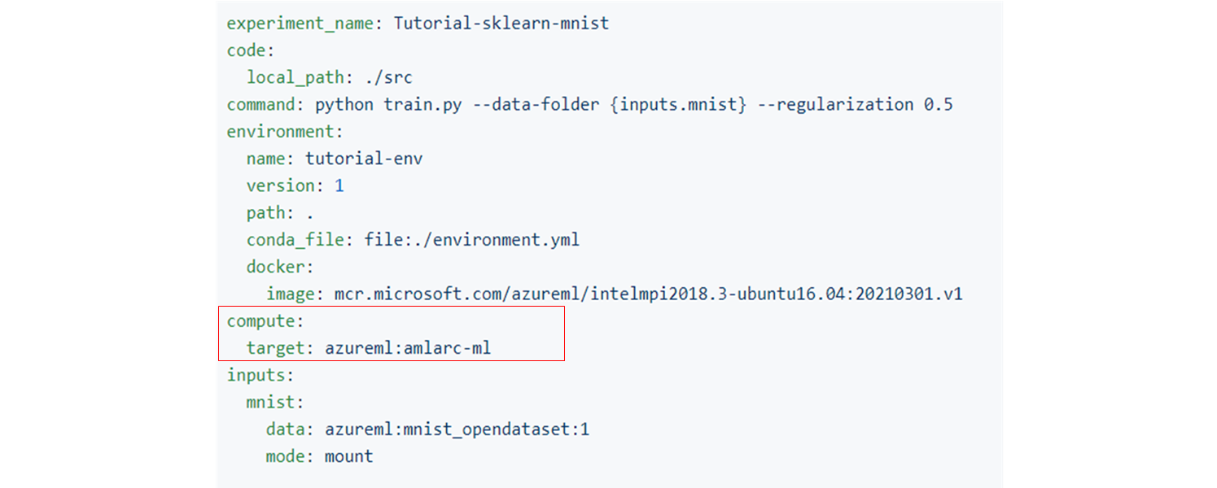
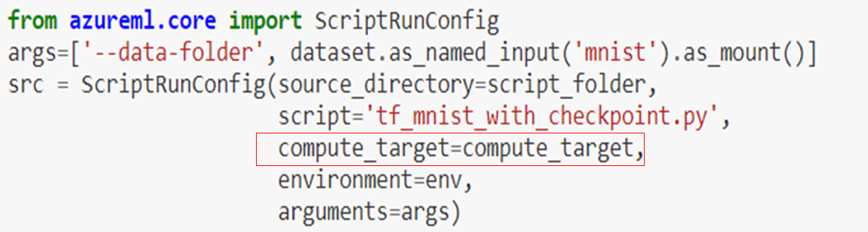
Using arc-enabled compute target
Arc-enabled compute target is just another compute target in Azure ML
Seamless experience and built-in Azure ML features support
Job submission via Python SDK, Studio GUI, or Azure CLI.
Notes:
Instance type is an unit of workload

Slide 19
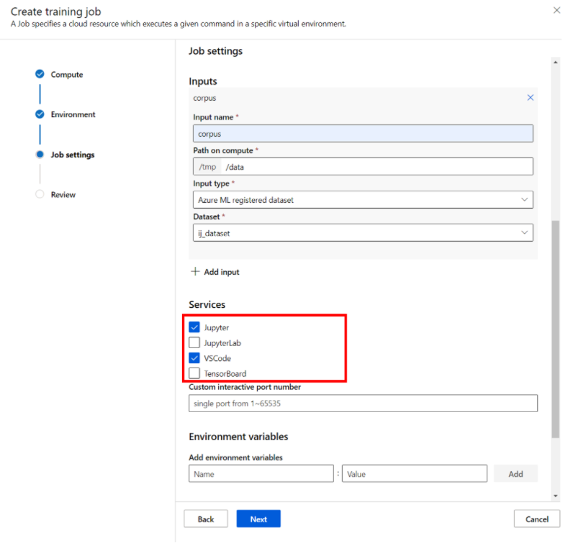
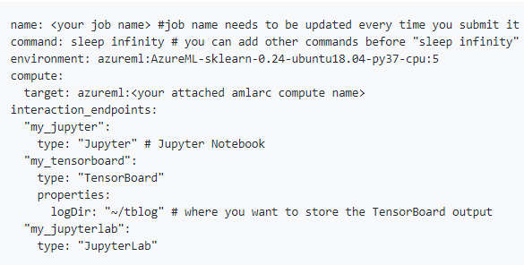
Submit an Interactive Job
Add "sleep <time>" in the command and specify the interaction endpoints
Azure ML 2.0 CLI
Azure ML Studio job creation UI
Create a job yaml job.yaml with below content.
Run command
az ml job create --workspace-name <your workspace name> --resource-group <your resource group name> --subscription <sub-id> --file <path to your job yaml file>

Slide 20
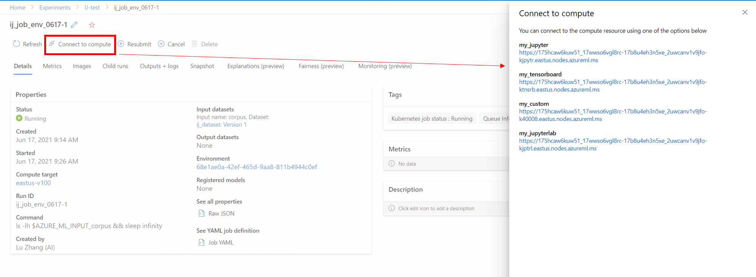
Connect to Interaction Endpoints
You can connect to these endpoints by clicking the links in the "Connect to compute" panel on run details page. Please note only job owner is authorized to connect to these endpoints.

Slide 21
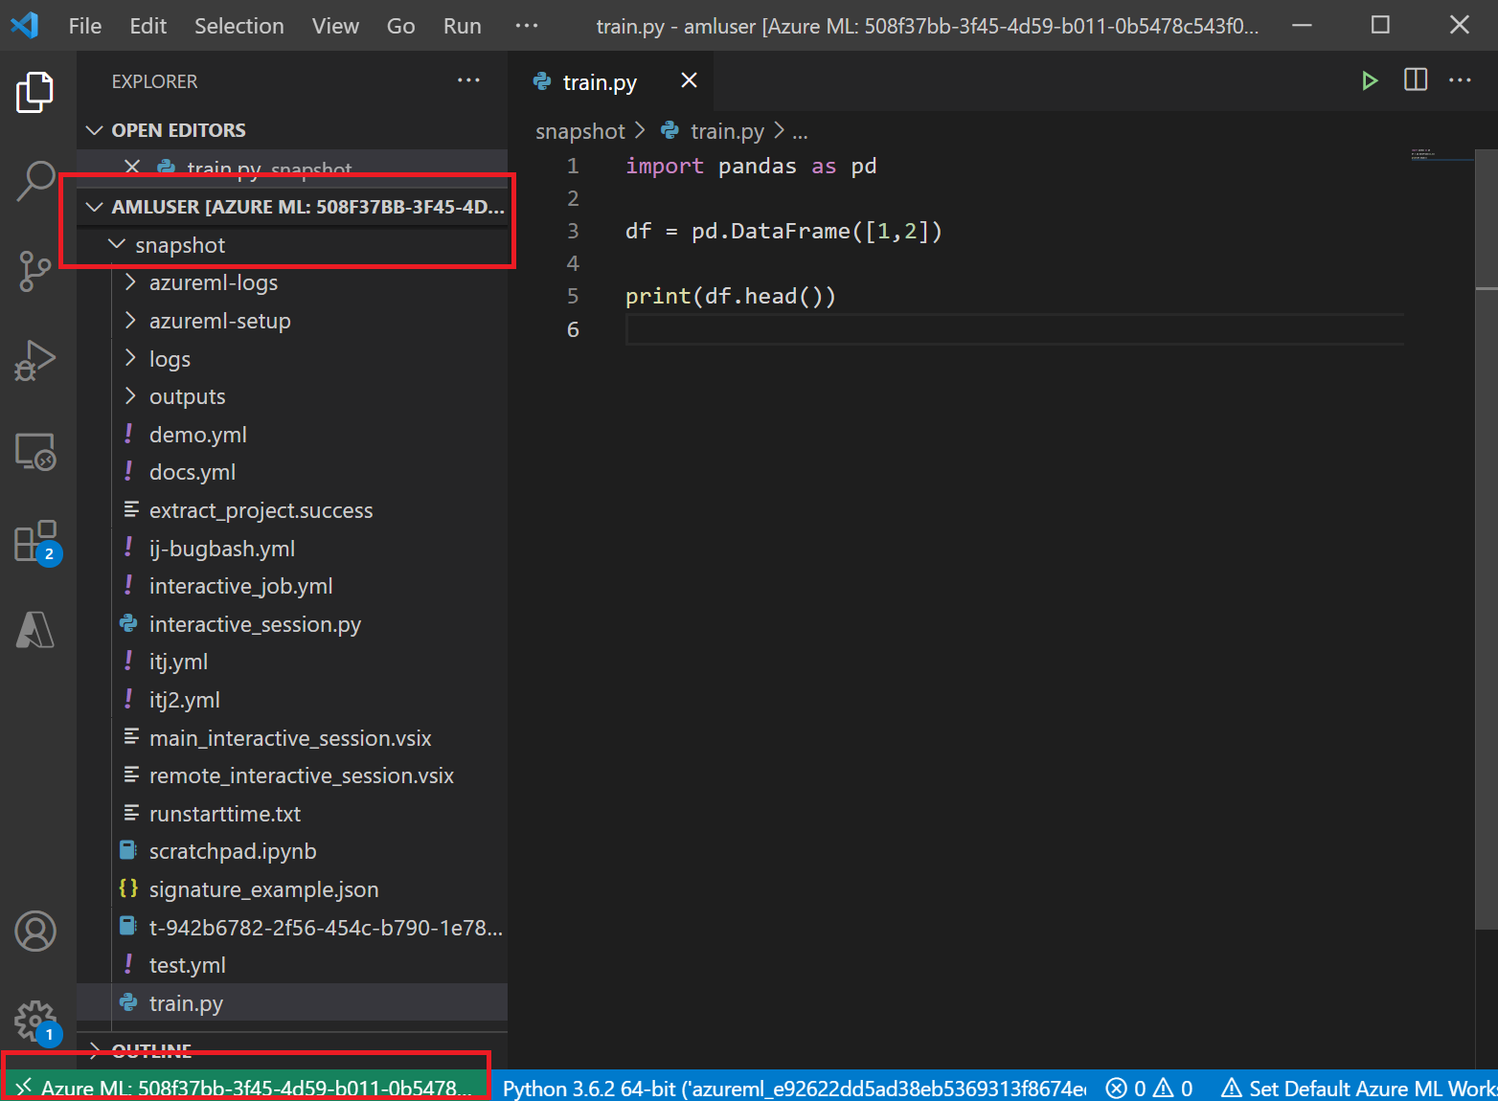
Interactive development in VS Code
The VS Code session sets connection between your local VS Code and the remote container.
You will have access to the /home/amluser in the container which will include softlinks to your code snapshot.
You can do interactive development and remote debugging with the same custom environment on VS Code.

Slide 22
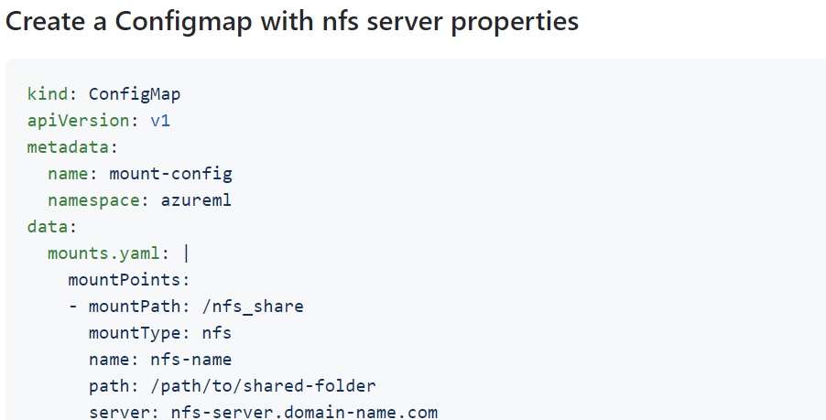
Local NFS access
Cluster operator can pre-provision permanent storage. System will mount the data in job runtime.
For example,
Cluster admin can set up a NFS server and create a ConfigMap with NFS server properties.
All jobs will look for the 'mount-config’. If this ConfigMap is missing or malformed then no mounts will be applied.
Data scientists can access the NFS data path in training job.
Notes:
Instance type is an unit of workload

Slide 23
Useful Links
Blog: Updates to Azure Arc-enabled Machine Learning - Microsoft Tech Community
GitHub Repo: azureml-examples/cli/endpoints/amlarc at main · Azure/azureml-examples (github.com)
Official documentation: Azure Arc enabled machine learning (preview) - Azure Machine Learning | Microsoft Docs
Sign up for Inference Private Preview: Azure Arc enabled Machine Learning - Inference Private Preview Sign-up (office.com)
Sign up for Interactive job Private Preview: Interactive Jobs Private Preview (office.com)

Slide 24
Roadmap
Training public preview / inference private preview (now)
Major Azure ML built-in features support
On-premise training with local data access (NFS)
On-premise training/inference with outbound proxy server support
Inference public preview and training refresh (ETA 11/2021 Ignite)
VNET/private link support
AutoSSL
Private container registry
On-premise data access (HDFS, S3, and more …) and dataset support
GA (ETA 03/2022 Ignite)

Slide 25
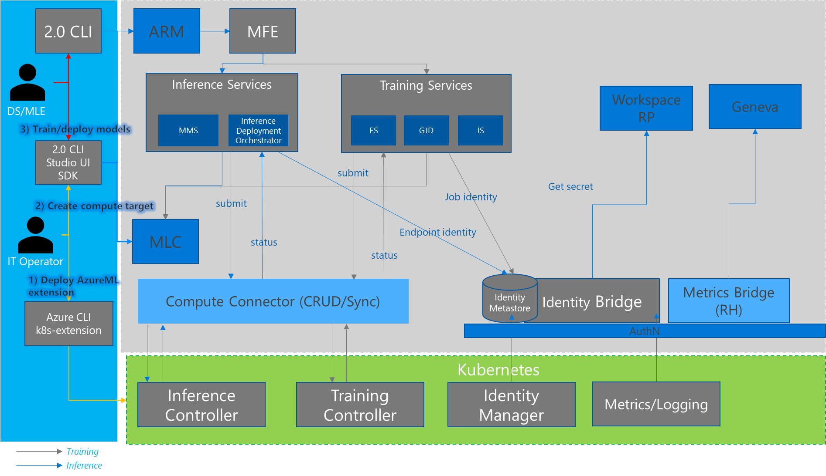
AmlArc architecture

